Slide 1

Portable Prevention Guidelines for the RDH
Protocols for Patient Care in Safety-net Settings
_____________________________________________________
Pam Cushenan, RDH, MS
SOFT Smiles: Specialized Oral-Focused Training
www.softsmiles.com
678-468-2535

Slide 2
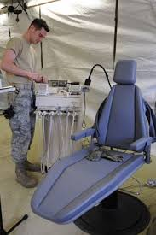
Objectives
State preparation methods to serve in safety-net settings
Demonstrate Portable Dental Equipment Set-up and Breakdown
Describe asepsis procedures for portable equipment
Discuss RDH armamentarium transport and management

Slide 3

Dental Hygiene Practice Requirements
Copy of Current Dental Hygiene License
  http://gadch.mylicense.com/PocketCards/
Copy of Current CPR Certification Card
  Submit all requests for duplicate or replacement cards directly to the Training Center that issued the original CPR card
Liability Insurance
  www.adhainsurance.com
  Call: 1-800-503-9230

Slide 4
Organization for Safety, Asepsis and Prevention (OSAP) Checklists
OSAP Site Checklist
  For new treatment site, equipment or provides.
  Used for Initial and periodic assessments
  Physical considerations: adequate space, proximity of water & electrical service, ventilation, & waste disposal
  Personnel: infection control training; exposure follow-up bt site personnel
OSAP Infection Control Checklist_portable equip
  Level 1 contact
  Assess Absence of resources
  Infection control: hand hygiene; PPE; immunizations; mgmt. of exposures; dental unit water quality

Slide 5
Portable Products Manufacturers
  A-dec www.a-dec.com
  Aseptico www.aseptico.com
  ASI Medical www.asimedical.net
  Bell dental Products www.belldental.com
  DNTLworks www.DNTLworks.com
  M-DEC (Mobile Dental Equipment Corporation) www.portabledentistry.com
  Safari Dental www.safaridental.com

Slide 6
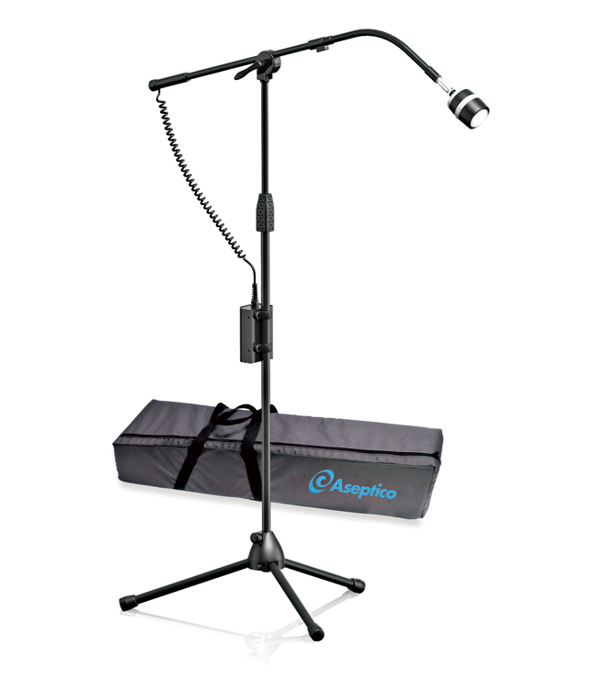
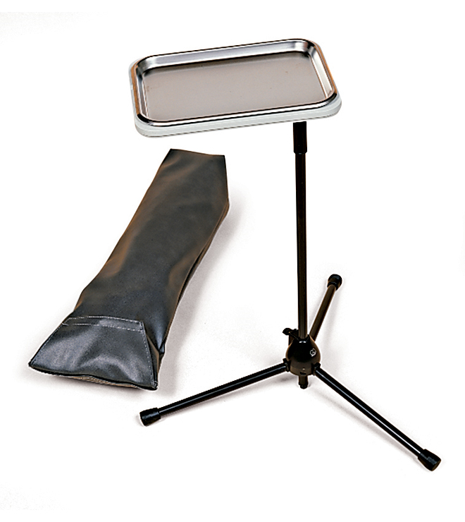
Portable Products
Basic Portable Dental Equipment
  ADU 17 Express Portable Dental System
    https://youtu.be/e-6Rj6n2l8U
  AseptiChair: ADC-01
  AseptiStool: ADC-08
  Portable Tray Stand: ATC-03CF
  LED light: ALU-40LED

Slide 7
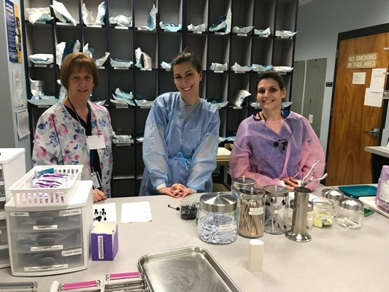
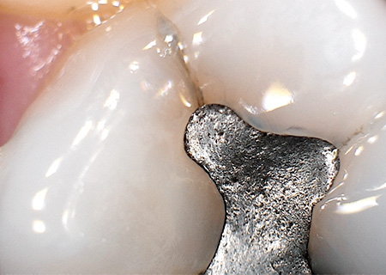
Armamentarium
Instruments
Cassettes
Prophylaxis Handpiece
Prophy Angles
Ultrasonic unit & inserts
Intraoral camera
PPE
Barriers
  Chair
  Suction
  Plastic wrap
  Blue wrap
Transport tubs (clean/dirty)
Suction
Gauze
Floss
Pumice
Fluoride varnish
Enviropouch
Sterilization bags
Hand Gel
BP Cuff
Antimicrobial rinse
Oral Hygiene products & aids

Slide 8
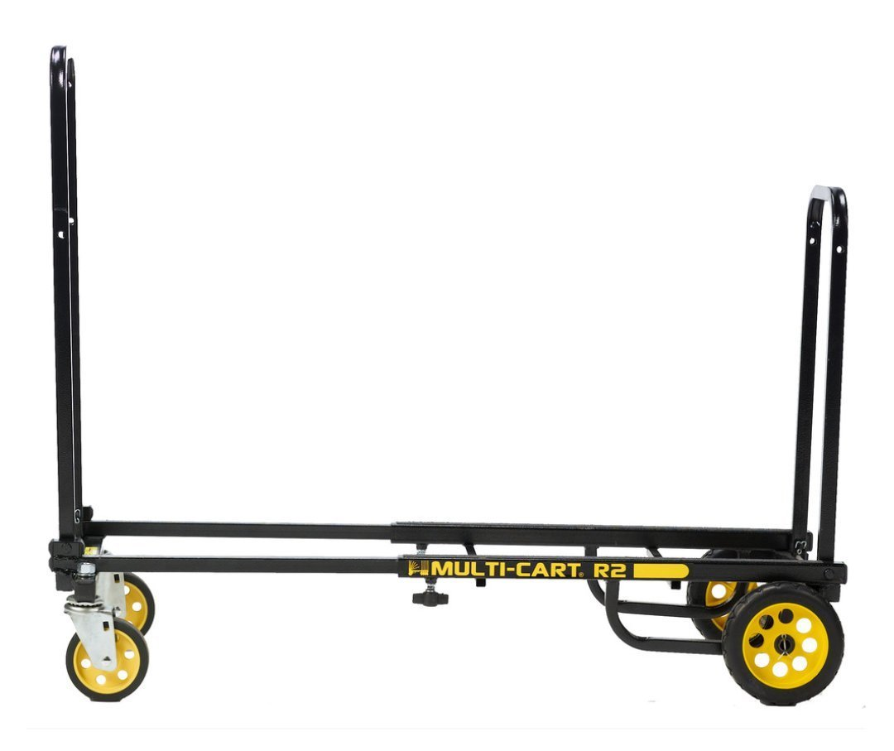

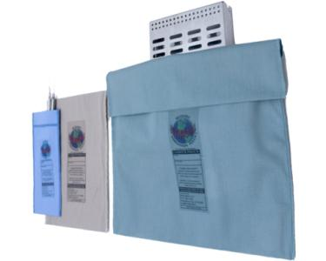
Preparation and Transport
Rock N Roller Multicart Model R2 Micro by Rock-N-Roller $74.00 Amazon
Plastic tubs with lock-down handles
Biohazard label required for “dirty” tub
Chair plastic barrier used as liner for dirty tub
Cassettes for instruments
  Cassette holds 8 instruments. Exterior Dimensions 3" x 8" x 1.5" (76 mm x 203 mm x 38 mm)
  Cassette holds 14 instruments. Exterior Dimensions 4.5" x 8" x 1.5" (114 mm x 203 mm x 38 mm)
Sterilization pouches to contain cassettes
Enviropouch for cassettes, instruments

Slide 9
Mechanical Assembly ADU-17 Express Portable Dental System
Set-up and Break-down
Operation & Maintenance Instruction Manual

Slide 10
Asepsis Regimen
Environmental infection control
  Mild cleaner
Clinical contact surfaces
  Disinfectant
    Cavicide
Unit Set-up
Water preparation (water bottles)
  Citrisil tablets
Barriers
  Chair, universal for suction & air/water syringe, over-gloves, plastic wrap
Armamentarium transport System
  Plastic locking bins (clean/dirty) with liners
Unit Break-down

Slide 11


Record keeping
Laptop
  Dentrix
  Eaglesoft
  Solutionreach
  iDentalSoft
Paper Charts
  File holder

Slide 12
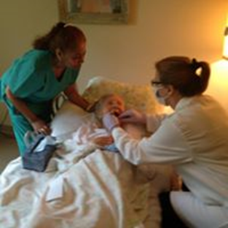
Summary
Establish relationship with setting coordinator
Assess Safety-net Setting in preparation for optimum preparation & implementation
Plan preventive services schedule
Assembly/Disassembly & Asepsis of portable dental equipment
Record-keeping methods
Expand the dental team by extending oral health professional services to vulnerable populations

Slide 13
References
Aseptico
www.Aseptico.com
Occupational safety and health standards: toxic and hazardous substances. Occupational Safety and Health Administration website. https://www.osha.gov/pls/oshaweb/owadisp.show_document?p_id=10051 &p_table=STANDARDS. 29 CFR 1910.1030. Published Dec. 6, 1991. Accessed April 18, 2017.
Summary of infection prevention practices in dental settings: Basic Expectations for Safe Care. Centers for Disease Control and Prevention website. https://www.cdc.gov/oralhealth/infectioncontrol/pdf/safe-care.pdf. Published March 2016. Accessed April 18, 2017.

Slide 14

Questions?
Contact information:
Pam Cushenan, RDH, MS
SOFT Smiles: Specialized Oral-Focused Training
www.softsmiles.com
https://www.facebook.com/SoftSmilesTraining/
678-468-2535

