Slide 1



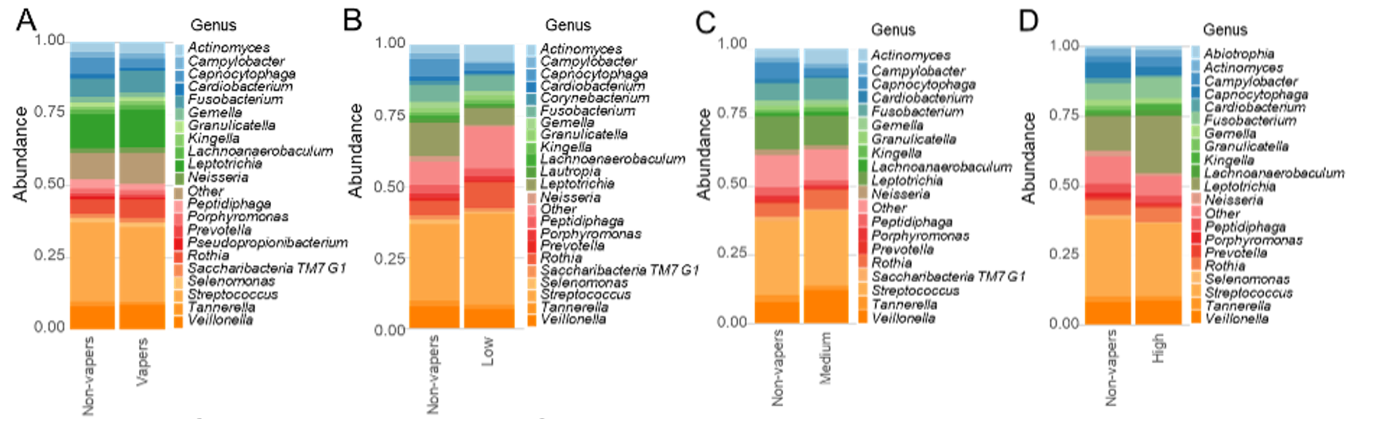
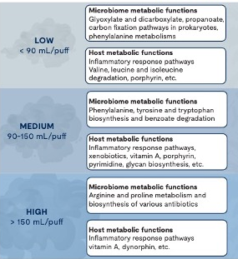
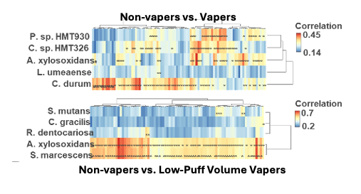
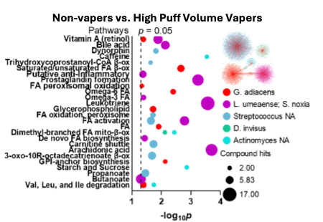
The Impact of Vaping Behavior on Taxonomic and Functional Changes within the Subgingival Microbiome
Irene Yang, PhD, RN¹; Xiaojia He, PhD²; Jennifer Jeon, MS¹; Henry Claussen, PhD¹; Robert Arthur, PhD¹; Pam Cushenan, MS, ASDH²;
Scott Weaver, PhD³; Ruiyan Luo, PhD³; Marilyn Black, PhD²;
Jonathan Shannahan, PhD⁴; Christa Wright, PhD²
¹Emory University, Atlanta, GA; ²Chemical Research Institutes,
UL Research Institutes, Marietta, GA; ³Georgia State University, Atlanta, GA;
⁴Purdue University, West Lafayette, IN
Background
Aim
Vapers are exposed to harmful substances (eg. nicotine, VOCs, and heavy metals). Exposure varies with vaping behaviors like puff volume. Vaping alters the microbiome taxonomically, suggesting an increased risk for periodontal disease (period), but little is known about functional changes.
To identify microbial taxonomic and functional alterations associated with vaping behaviors and periodontal disease (PerioD).
Results
Methods
Taxonomic Alterations
48 vapers, 22 controls, aged 18–35 with ≥16 natural teeth
Collected saliva, subgingival plaque, puffing behavior (low, medium, and high volumes), and device VOC emissions
Periodontal status via CPITN
16S rRNA sequencing with LDM for differential taxa analysis; functional profiling with Microbiomeanalyst 2.0, and Tax4Fun2
Salivary metabolomics (LC-MS); microbiome-metabolome correlations with Procrustes
Integrated data via xMWAS
All analyses adjusted for age, sex, race, and sugar intake.
  Vapers exhibited decreased abundances of beneficial taxa like Bacteroidetes and increases in potentially pathogenic taxa like Spirochaetes and Synergistetes.
  Similar shifts of decreasing commensals and increasing pathogens were observed across all puff-volume groups.
  Alpha diversity was significantly lower in high puff volume vapers.
Paired Microbiome-Metabolome Analysis
Enriched metabolites, including nicotine derivatives, antibiotics (eg. neomycin, kanamycin), and vitamin cofactors were identified in vapers.
Key correlated taxa including C. durum, A. xylosoxidans, and S. marcescens were associated with specific metabolites like nicotine derivatives and antibiotics.
Functional Alterations
Integrative Microbiome-Metabolome Analysis
Vapers’ topological communities revealed pathways involved in lipid regulation, inflammatory response and bile acid biosynthesis, with taxa like L. umeanse and S. noxia showing strong correlations with metabolic features.
Conclusion
Vapers exhibited shifts in their subgingival plaque microbiome, with reductions in beneficial bacteria and increases in pathogenic taxa. Shifts were linked to enriched inflammatory, lipid, and xenobiotic pathways. Analyses revealed complex interactions between vaping intensity and oral microbiome and metabolic profiles, suggesting that vaping, especially with medium and high puff volumes, may increase PerioD risk, emphasizing the need for further research and targeted interventions.
Acknowledgement: This work was supported by funding from the NIH-NIDCR (1R56DE031814-01)

